Slide 1
Creating iOS & Android apps
in .NET Using Xamarin
[Your Name]
[Your Title]

Slide 2
The History of Architecting Mobile Apps

Slide 3

Silo approach
iOS
Android
Windows
Objective-C/Swift
Xcode
Java/Kotlin
Android Studio
C#
Visual Studio
No shared code • Many languages and development environments • Multiple teams

Slide 4
Xamarin’s unique approach
iOS C# UI
Android C# UI
Windows C# UI
Shared C# Logic
Shared C# codebase • 100% native API access • High performance

Slide 5




Xamarin
iOS C#
Android C#
Windows C#
Shared C# Logic
3 Native User Interfaces
Shared App Logic

Slide 6
Everything you can do
in Objective-C, Swift, Java or Kotlin
can be done in C# with Xamarin

Slide 7

Mono Runtime
Open Source .NET Runtime
Allows .NET to run on Linux
Founded in 2004
Converging with .NET Core in .NET 5

Slide 8


Open Source
+

Slide 9

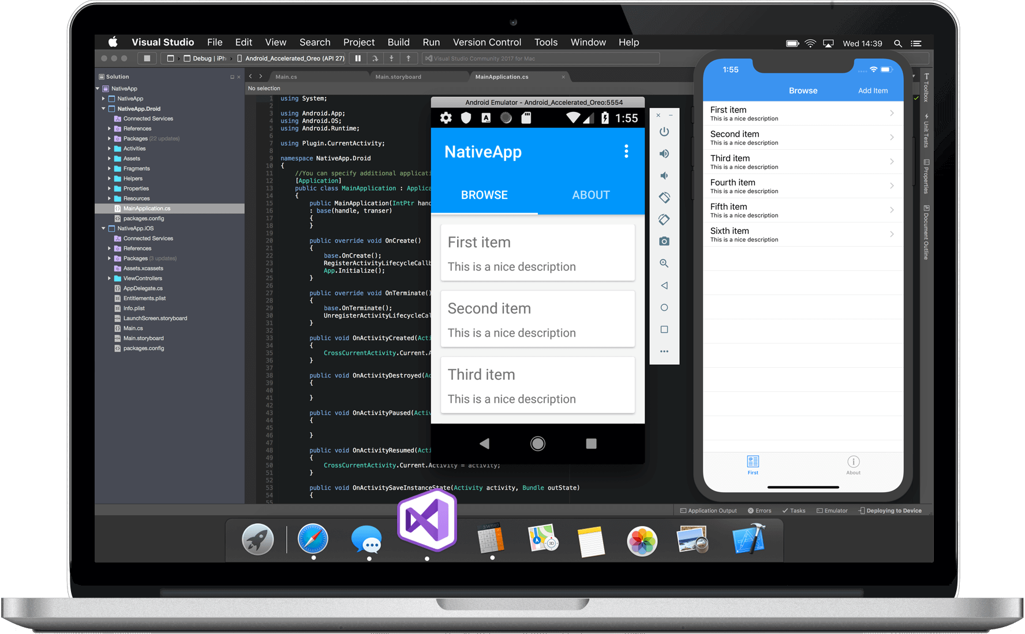
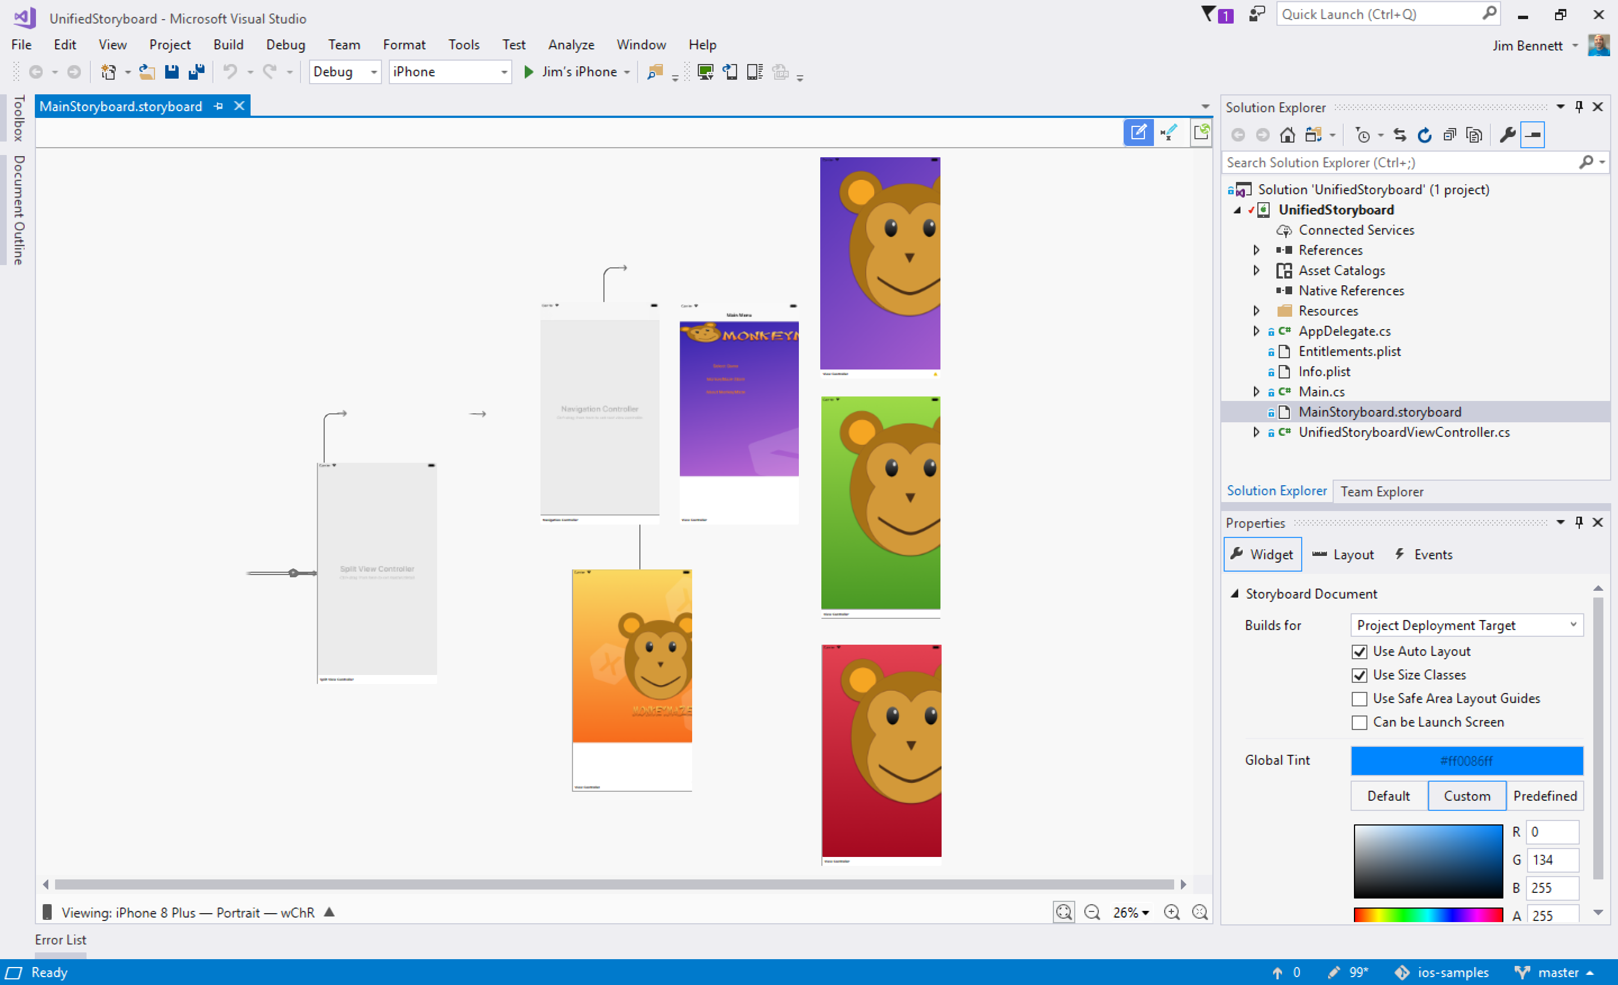
Visual Studio (PC)
Visual Studio for Mac

Slide 10
Demo
Xamarin.iOS
Xamarin.Android

Slide 11
Sharing User Interface

Slide 12
Xamarin
+ Xamarin.Forms
iOS C# UI
Android C# UI
Windows C# UI
Xamarin.Forms
Shared C# Logic
Shared C# Logic
Traditional Xamarin approach
With Xamarin.Forms: More code-sharing, all native

Slide 13
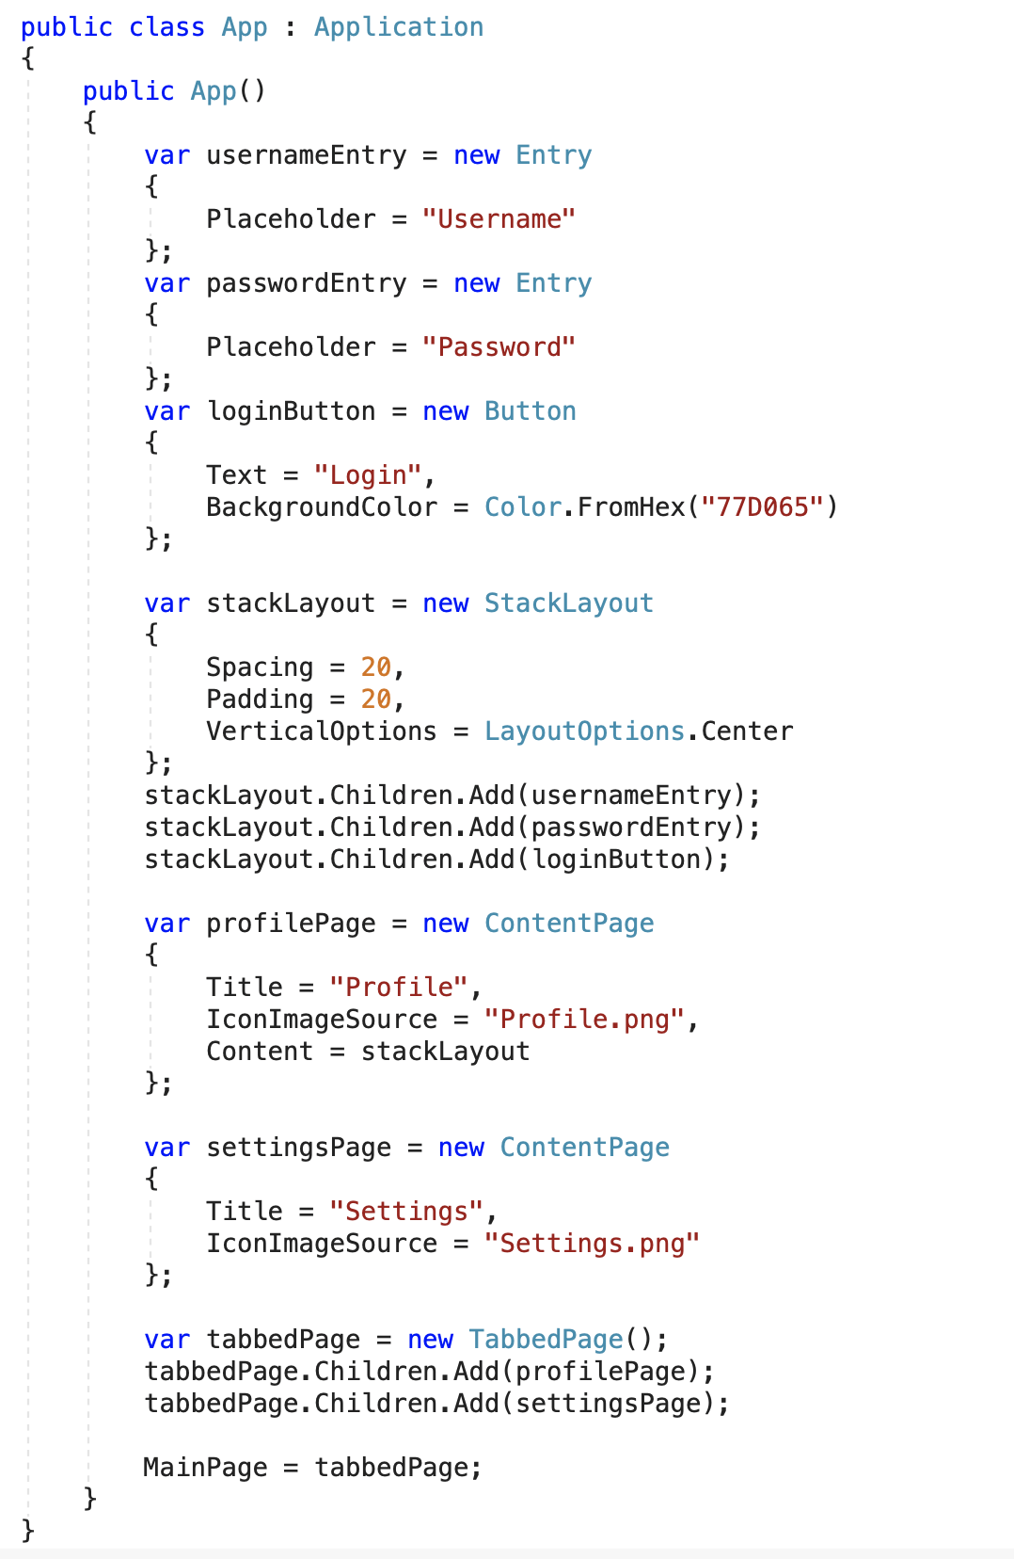
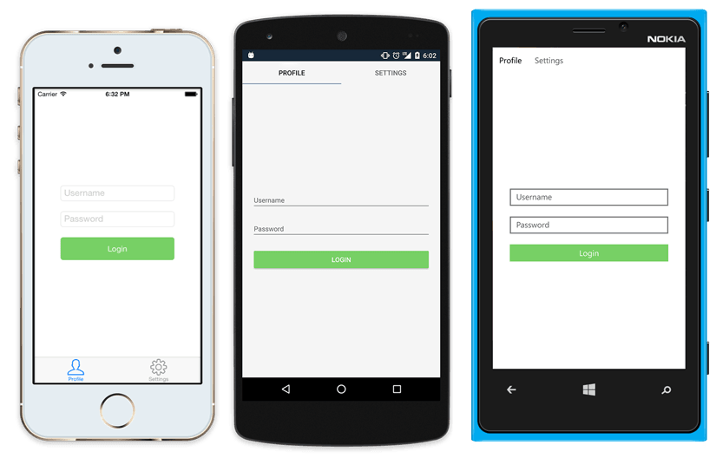
Native UI from shared code
<?xml version="1.0" encoding="UTF-8"?>
<TabbedPage xmlns="http://xamarin.com/schemas/2014/forms"
xmlns:x="http://schemas.microsoft.com/winfx/2009/xaml"
x:Class="MyApp.MainPage">
<TabbedPage.Children>
<ContentPage Title="Profile" Icon="Profile.png">
<StackLayout Spacing="20" Padding="20"
VerticalOptions="Center">
<Entry Placeholder="Username"
Text="{Binding Username}"/>
<Entry Placeholder="Password"
Text="{Binding Password}"
IsPassword="true"/>
<Button Text="Login" TextColor="White"
BackgroundColor="#77D065"
Command="{Binding LoginCommand}"/>
</StackLayout>
</ContentPage>
<ContentPage Title="Settings" Icon="Settings.png">
<!-- Settings -->
</ContentPage>
</TabbedPage.Children>
</TabbedPage>

Slide 14
Demo
Xamarin.Forms

Slide 15
Quick Review

Slide 16
Xamarin
Native Mobile Development in .NET
Wraps 100% of iOS and Android APIs
Powered by the Mono Runtime

Slide 17
Xamarin.Forms
Shared UI Code
Runs on top of Xamarin

Slide 18

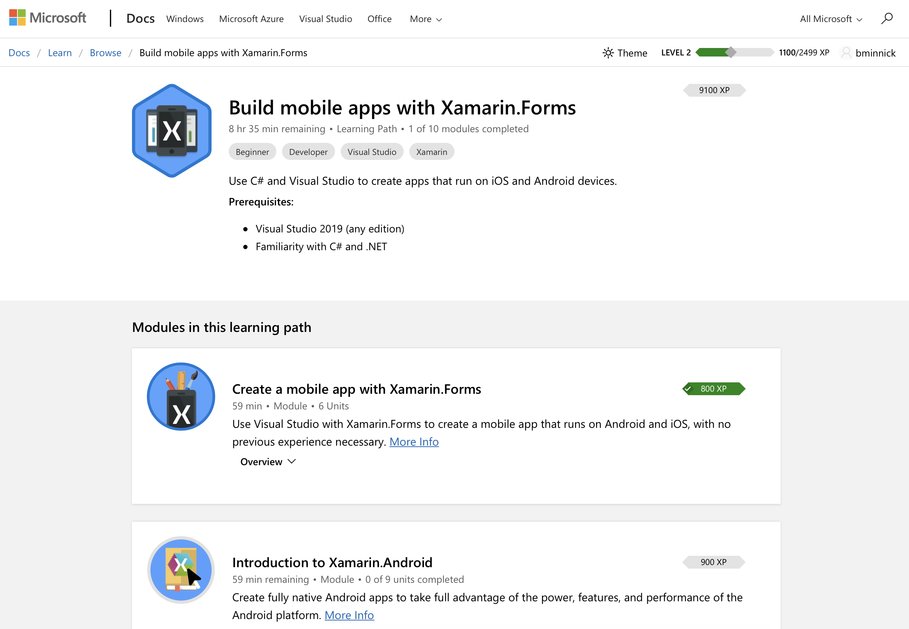
Microsoft Learn

Slide 19










Microsoft Learn
Interactive, step-by-step exercises
Quizzes + Achievements
@TheCodeTraveler
https://www.codetraveler.io/DWX-Xamarin/

Slide 20
Demo
https://microsoft.com/learn
Notes:
Demo Forms

Slide 21
Thank You

